Slide 1


Business Advisory Councils
3313.82 Business advisory councils.
The board of education of each school district and the governing board of each educational service center shall appoint a business advisory council, except that a school district that has entered into an agreement under section 3313.843 or 3313.845 of the Revised Code to receive any services from an educational service center is not required to appoint a council if the school district and educational service center agree that the educational service center's council will represent the business of the district. The council shall advise and provide recommendations to the board on matters specified by the board including, but not necessarily limited to, the delineation of employment skills and the development of curriculum to instill these skills; changes in the economy and in the job market, and the types of employment in which future jobs are most likely to be available; and suggestions for developing a working relationship among businesses, labor organizations, and educational personnel . Each board shall determine the membership and organization of its council. Notwithstanding division (D) of section 3311.19 and division (D) of section 3311.52 of the Revised Code, this section shall not apply to the board of education of any joint vocational school district or any cooperative education school district created pursuant to divisions (A) to (C) of section 3311.52 of the Revised Code.

Slide 2
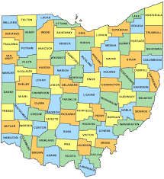











1550 Students
160 Square Miles
3 Buildings
36% Economic Disadvantage

Slide 3
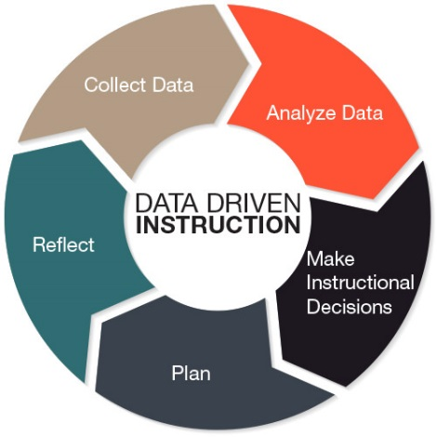



Student Programming
Literacy
Instructional Strategies
Intervention
Professional Development
Career Connections K-12
Student Wellness
Community Engagement
Communications and Branding
Prepare, Challenge, Empower

Slide 4
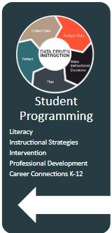
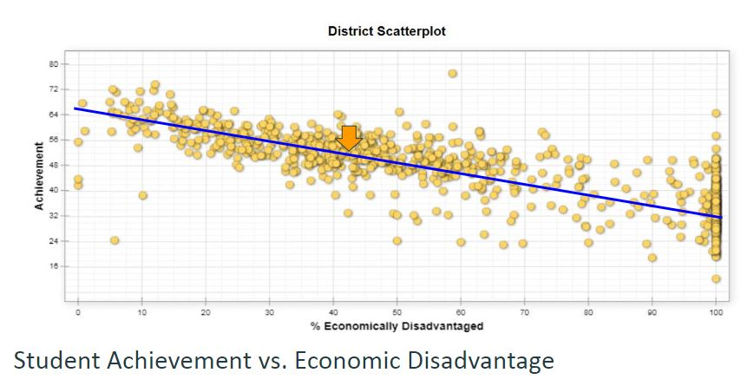
Achievement vs. % Economically Disadvantage

Slide 5
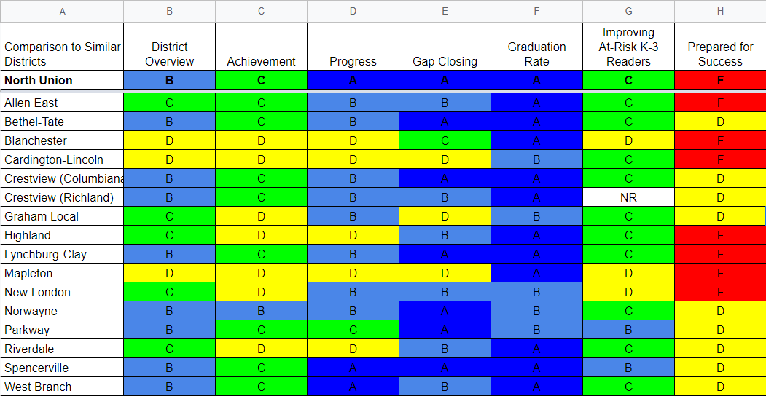
Report Card Comparison.

Slide 6









Slide 7
Labor Study
To get an idea of what you will make, I looked up some statistics with the United States Bureau of Labor Statistics. They say that of the 102 of you, according to current employment data in rural northwest ohio, 24 of you will be in production occupations, you will make cars, or appliances, or parts, or any other products that we buy. That is the number one occupation in this area of the state. Next, 13 of you will make copies, presentations, phone calls in the occupation of office and administration support. Nine of you will make deliveries in the transportation and material moving occupations.
Eight more of you will make breakfast, lunch, and dinner in the foodservice industry, six of you will go into education, and as we say in education, you will make a difference.
The list goes on, three of you will make money in finance, one of you will make peace in law enforcement and what was surprising to me, it will take five classes of at least 100 students before we have one student that will make the most fundamental product in our society, food, in the farming industry.

Slide 8
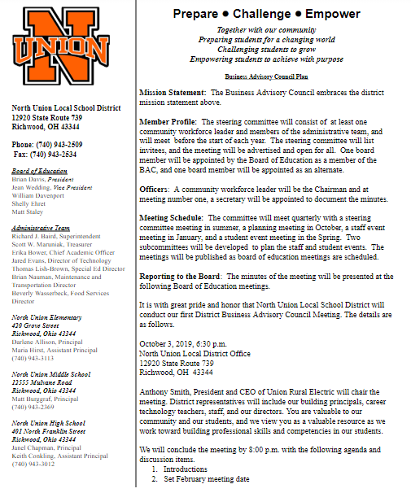
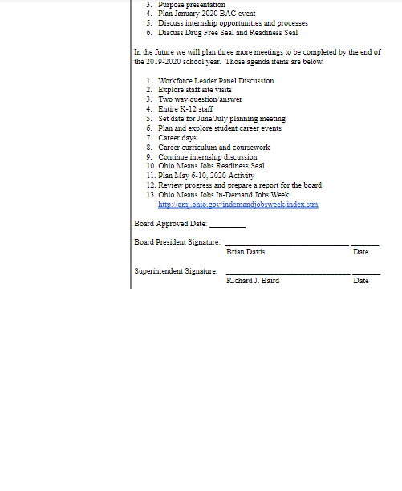
Do NOT leave regional BAC.
Very valuable for perspective and ideas Saves you work

Slide 9
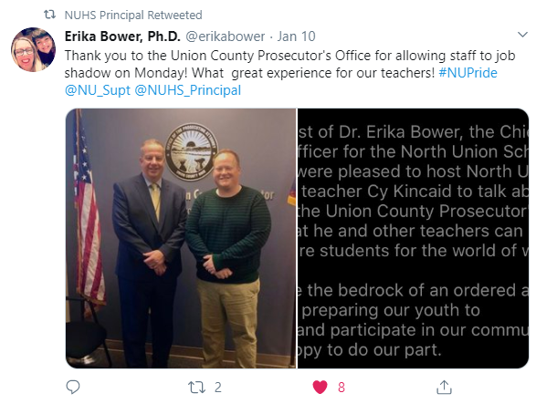
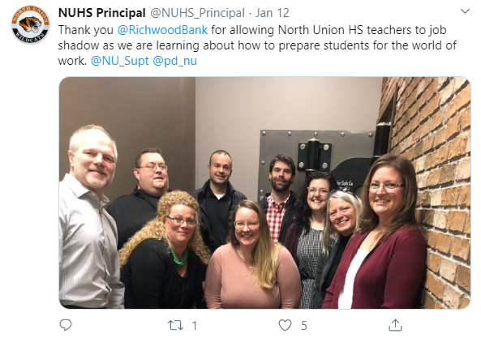
Remain Open Minded with your agenda.

Slide 10
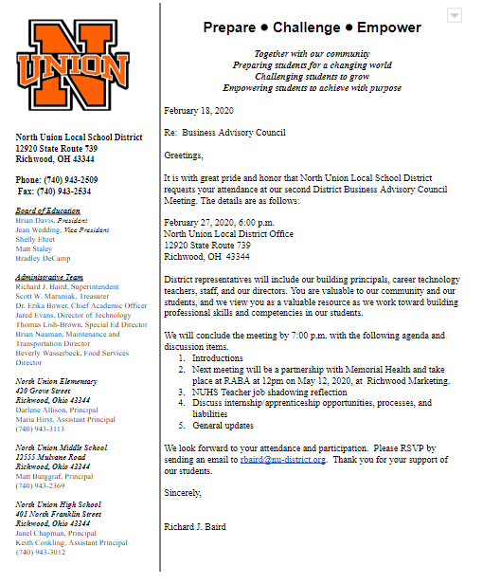
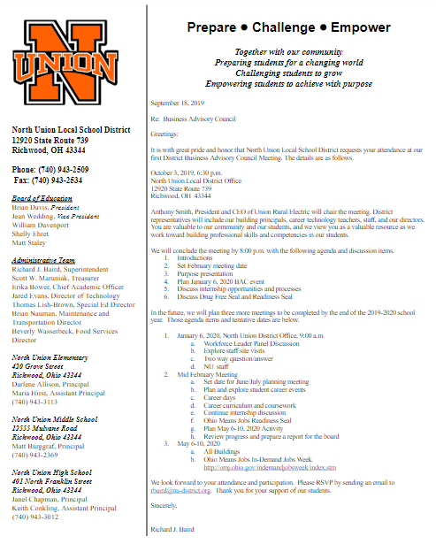
Invite everyone

Slide 11


The beginnings of the BAC
Founded in 1984
Bylaws were created
Roles of the membership established
Chairperson selected

Slide 12
Evolution over time
Roles have shifted over time
BAC founded the Dublin Education Foundation
Initially there were committees
Some years meeting attendance was sparse
Today it is a robust group who provide invaluable feedback and ideas

Slide 13
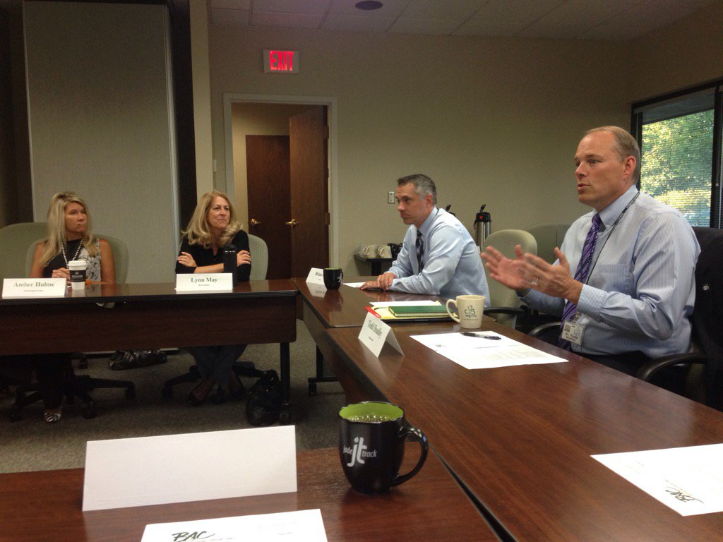
Mission of the BAC Today
The Dublin City Schools Business Advisory Council provides valuable feedback on industry trends, skills students need to succeed in the workforce, and curriculum improvements to maximize success.

Slide 14
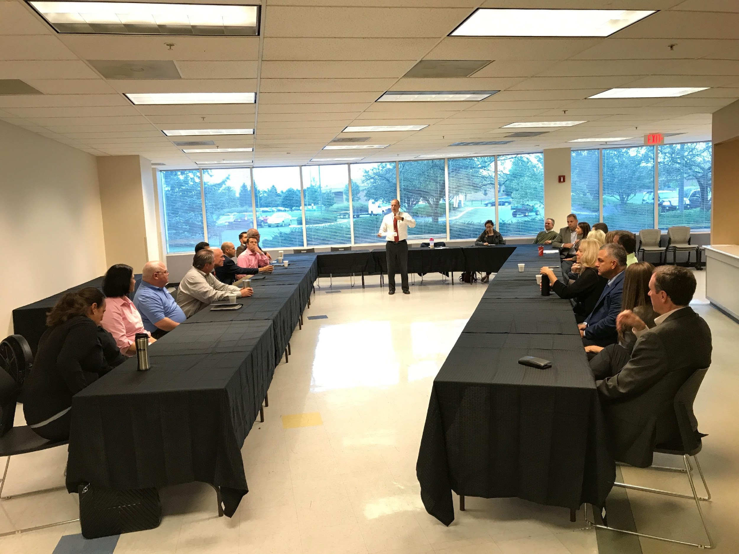
Structure of the BAC
Chairperson nominated by the membership
• Board of Education members
Superintendent
20-25 members

Slide 15
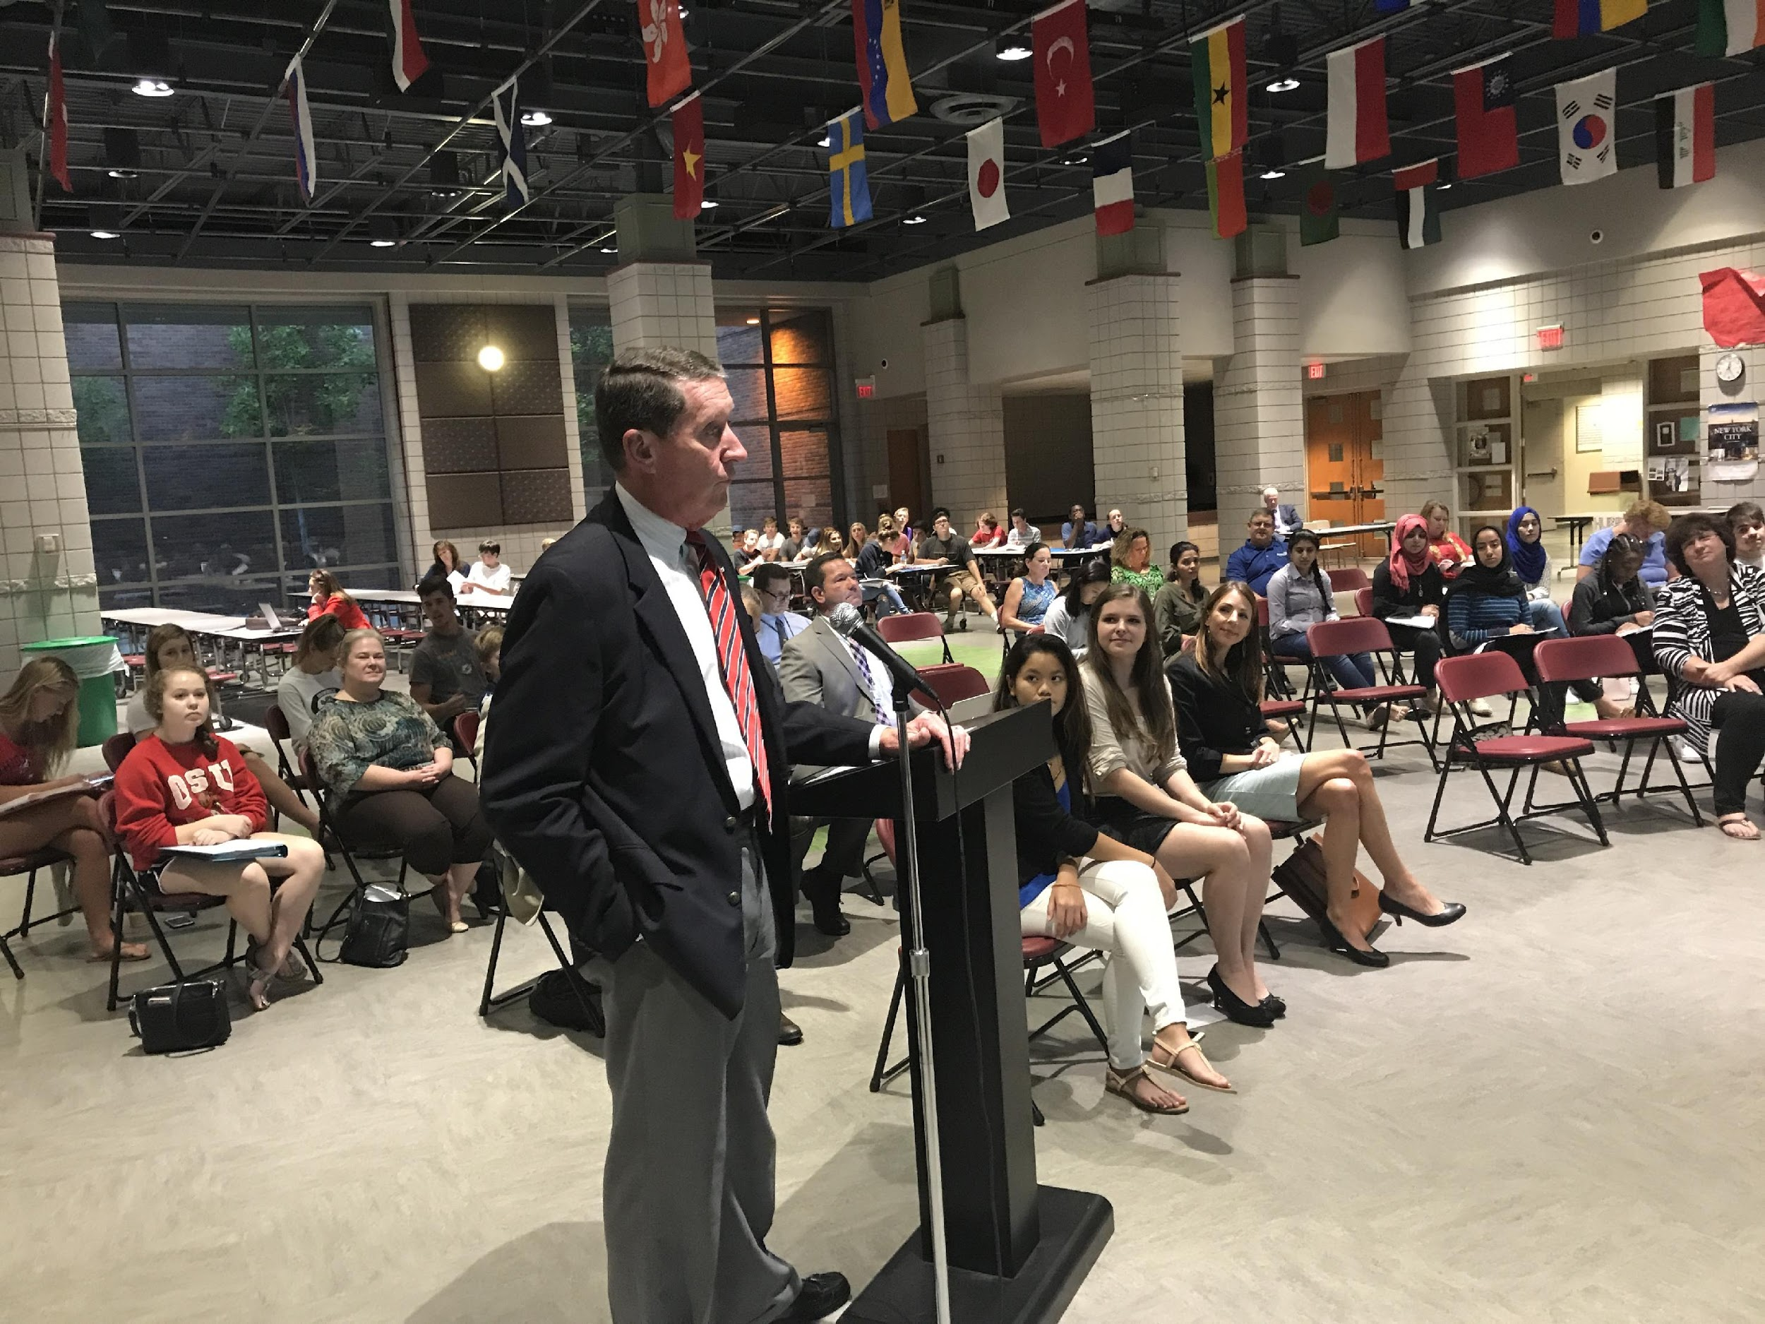
Growing the membership
BAC members are usually hand selected
Board President signs off on new BAC members
Members should work at a company in the district
BAC members who are parents added bonus

Slide 16
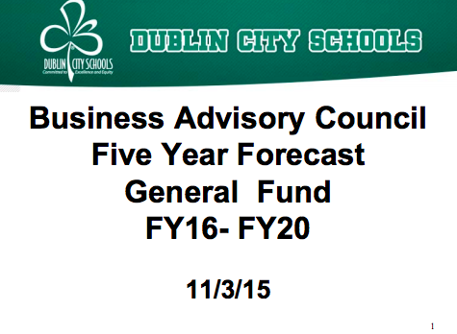
District Finances and the BAC
Review of 5-year forecast
Third party validation
Health insurance

Slide 17






Large companies
PV

Slide 18






Smaller companies
PV

Slide 19




Government agencies

Slide 20
Business Advisory Councils
Questions?

